Slide 1

Quick Start With Astro-Data It’s not all Black and White with Pandas
Soheb Mandhai

Slide 2
Disclaimer
This session acts as a reference guide – I’m not a Python wizard by any means, I just have a couple of years of experience with it and am also learning.

Slide 3

Resources – Follow Along
Github Repo: https://github.com/smandhai/Astro-Data-Handling-Tutorials
Aim: To make you aware of what python can do for you. It’s up to you to follow up these threads and read the documentation!

Slide 4


Slide 5
Downloading Data

Slide 6

Methods to Download Data
Astroquery – For downloading FITS and skymaps
Wget – Can be used via bash or through the python package of the same name. Downloads via url
Urllib – Package designed to handle url requests.
SQL – Some python packages allow you query databases via SQL
Manual – Download a file straight from the source

Slide 7
File Formats

Slide 8


Common Types
Typical data formats that you will encounter:
CSV (Comma-Separated Value)
TXT (Text File)
Dat (Data File)

Slide 9
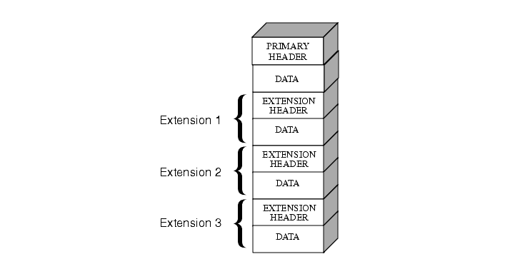
FITS
Data format that can hold multiple sets of data
Described by the header
Can be accessed/viewed with:
Specialised programs
Astropy
DS9
Image Credit: Science Telescope Science Institute

Slide 10
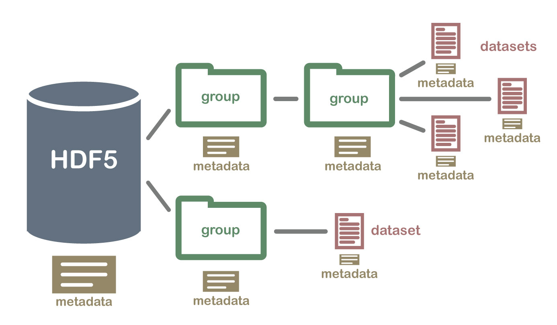
HDF5/H5 FIles
Hierarchical data storage
Can load in subsets individually
Making it ideal for storing simulation data
Can store variables as “attributes”/”metadata”
Image Credit: National Ecological Observatory Network

Slide 11
Loading In Data Files

Slide 12


Common Packages to Load in Files
Pure Python – Read in files line by line
CSV – Operations to read files line by line but specialised for CSV files
Numpy – Can load in a multitude of files and store them as nd-arrays
Astropy – Can load in ascii data files and FITS
H5PY – Specialised for loading in h5/hdf5 files
Pandas – Great for loading in tables and data with different d-types

Slide 13
Loading in Big Files
Skip rows (for sampling) – Numpy/Pandas have their own implementations
Chunking (Pandas) – Allows you to access a part of a data file
Using For loops, you can access chunks
For example: 1x20GB file can be chunked into 10 x 2GB parts. Can process each chunk individually this way.
Caveats: Only useful for data where analysis can be conducted on subsets and combined

Slide 14
Processing Data Files

Slide 15

Common Methods to Process Data FIles
Numpy is your friend – Can handle arrays and most mathematical operations
Can also produce recarrays – a crossover between a dictionary and an array. Can use dictionary conventions to access specific arrays.
Numbas – for parallelisation and deployment on GPUs
Pandas - Allows mathematical operations and can even handle cross-matching, sorting, filtering of multiple data tables!

Slide 16
Visualising Data

Slide 17
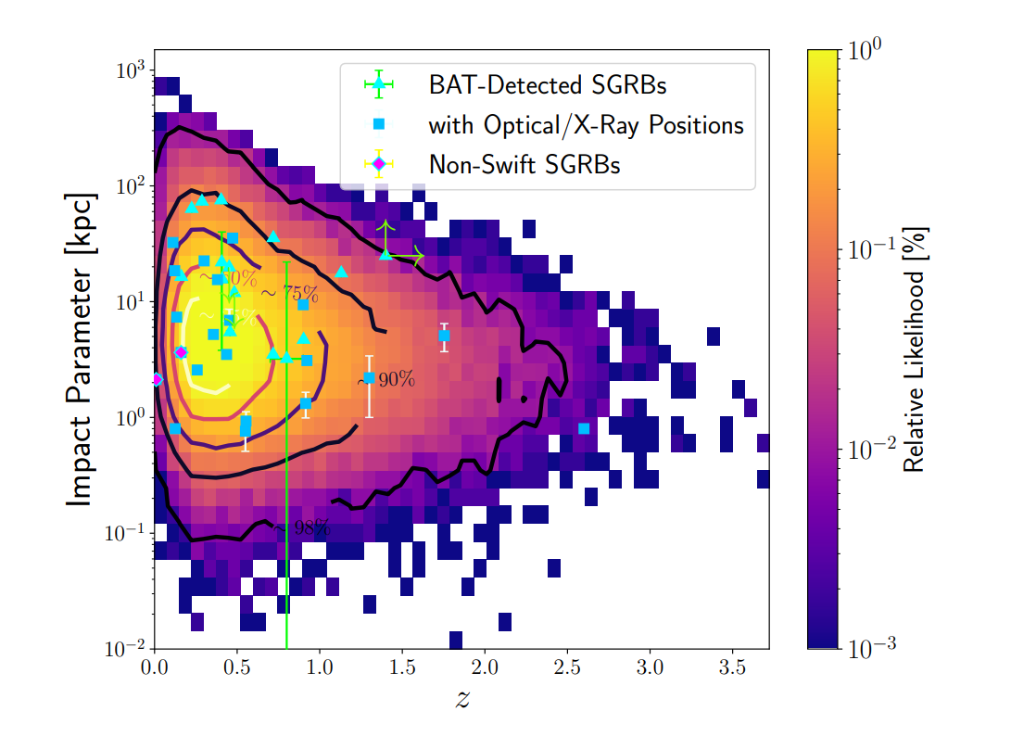
Matplotlib
Check out Josh Hayes’ Guide: https://github.com/joshjchayes/matplotlib_guide
Great for visualising data
Well documented
Main package used for plotting in Python
Image Credit: Mandhai et al., 2022

Slide 18
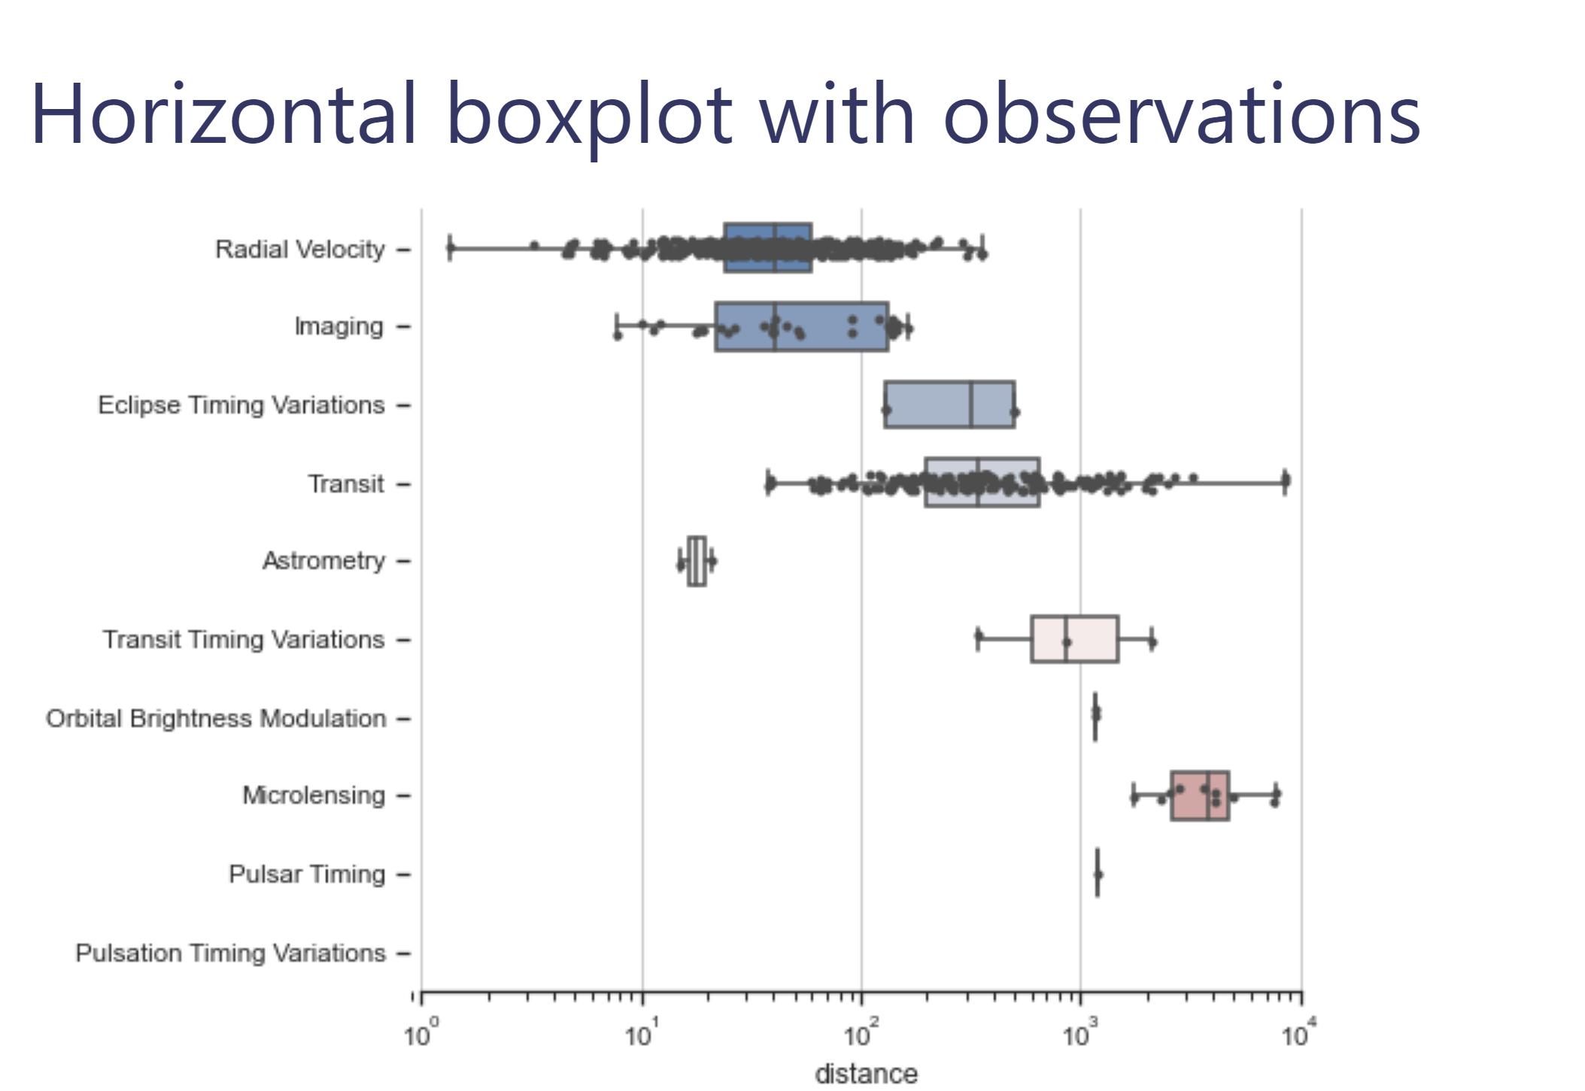
Seaborn
Site: https://seaborn.pydata.org/
Based on Matplotlib
Can load datasets
Convenient for producing statistical graphs
Functions ready to use for creating common types of graphs
Image Credit: Seaborn

Slide 19
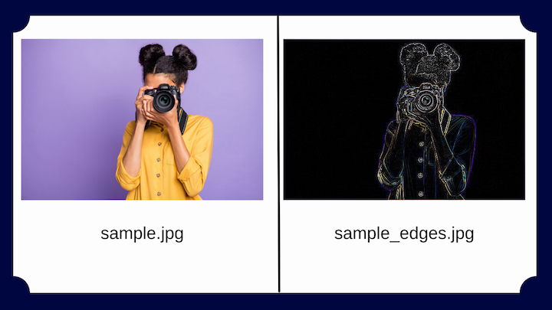
PILLOW
Site: https://pillow.readthedocs.io/en/stable/handbook/overview.html
Designed for loading images
Great for manipulating images
Can be used for art/preparing image data for creating training datasets
Can work in tandem with matplotlib
Can load images directly from a URL
Using pillow – you can create LUTs and image filters
Image Credit: LogRocket Blog - https://blog.logrocket.com/image-processing-in-python-using-pillow/

Slide 20

ACTIVITY TIME
On the padlet:
State: What do you like to see in graphs and plots?
Which features do you tend to dislike in plots?
Do you have any cool figures? If so, add them do the padlet.
URL: https://padlet.com/soheb_mandhai/jacs-2022-2023-padlet-xpcfpmv22utnsrza

Slide 21
Storing Data

Slide 22
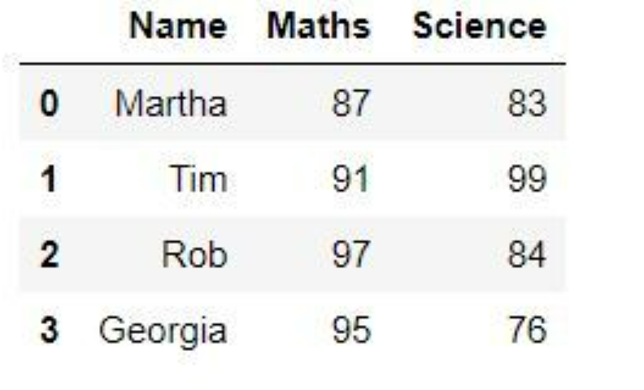
Data Ndarrays
Tables:
Pandas stores data as dataframes/tables
PyTables is useful for handling SQL data in table form
Benefits:
Well indexed
Columns can be displayed clearly and easily
Arrays
Dictionaries:
Can be parsed into Pandas and converted to dataframes
Saving:
Numpy/Pandas/Astropy/Pure Python have routines that can output data to files – check the documentation for your use case.
Image Credit: GeeksforGeeks

Slide 23

Caching Data
Pickling
Pickling – Converts a python object into a “byte stream” for them to be unpickled later and converted back into a python object.
Loading/Saving
Loading/Saving with numpy – you can store numpy variables easily with np.save/np.load.
For storing large arrays and datasets, use other numpy methods.

Slide 24
Arrays

Slide 25
Dictionaries

Slide 26
Homework
Use the principles introduced here to create a creative visualisation of the data within the supplementary Jupyter/colab workbook.
Tasks:
Create an inset plot – Spectral data plotted over the sky map
Add arrows and labels
Add text
Use appealing colours
Bonus: Are there any other features in the included data that can be plotted? Show this in grid form if so.
PRIZE: A Chocolate Easter Egg/Or something similar. E-mail your entries to me by the end of next Friday (3rd March).

Slide 27
TIPS

Slide 28

Pseudocode
Write out your algorithm in basic English – create a step by step guide of your logic:
Benefits: This lets anyone translate your algorithm to another programming language if needed
For example, Making Tea – The Algorithm:
Acquire Cup, Tea Bag, Milk, Sugar
Go to Kettle
Check Kettle Water
If water is low:
Refill water
Turn kettle on
Wait
Place Tea Bag in cup with Sugar (NOT MILK – I WILL FIND YOU)
While water == not hot:
Wait
If kettle == done:
water= hot
Pour Water into cup
Stir
Add Milk
Drink

Slide 29






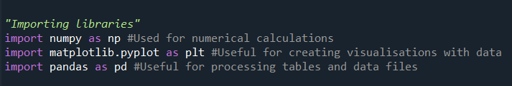
Common Libraries

Slide 30
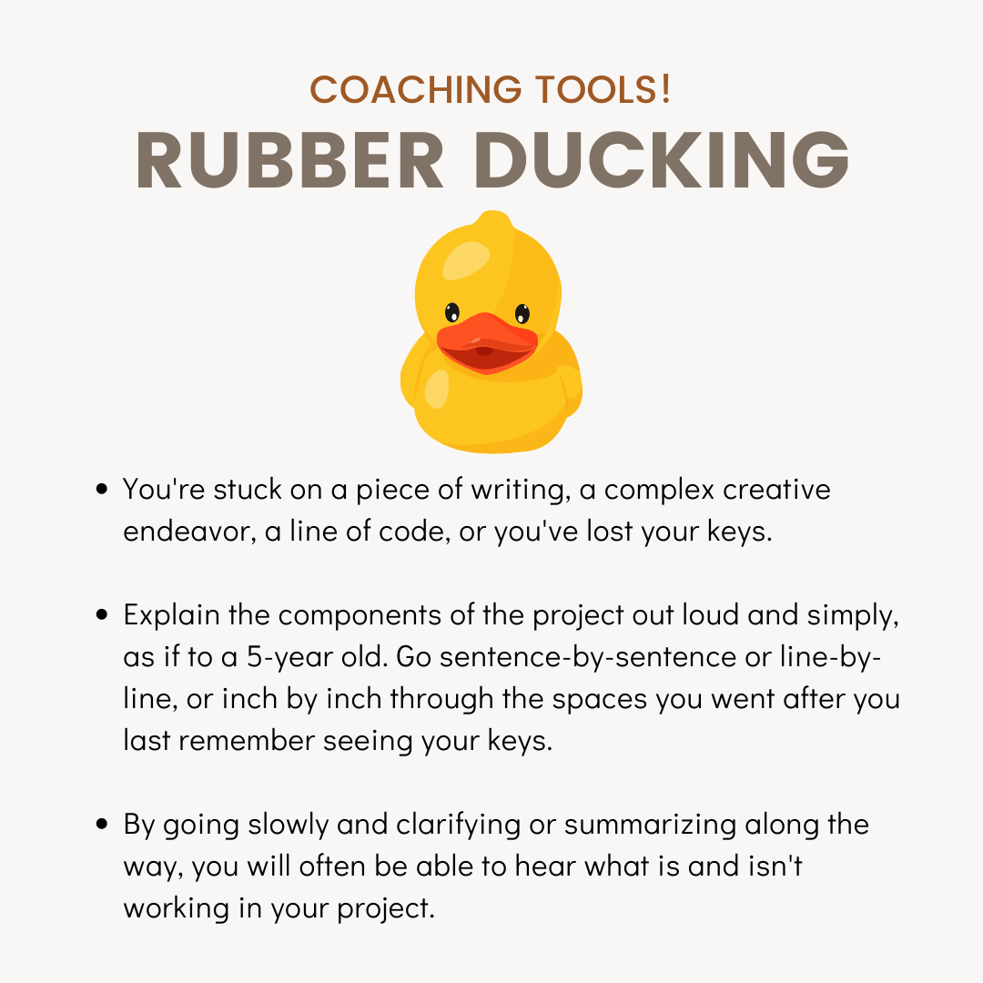
Debugging
Check variable explorer in an IDE to ensure values are what you expect
Narrate your code to a friend or a rubber duck (Rubber Ducking)
Use print statements around offending areas
Follow the traceback
Credit: V & CO Coaching

Slide 31
Additional Resources

Slide 32
Need Help?
StackOverFlow
Your Colleagues
W3Schools
Coding Academy
Many More…

Slide 33
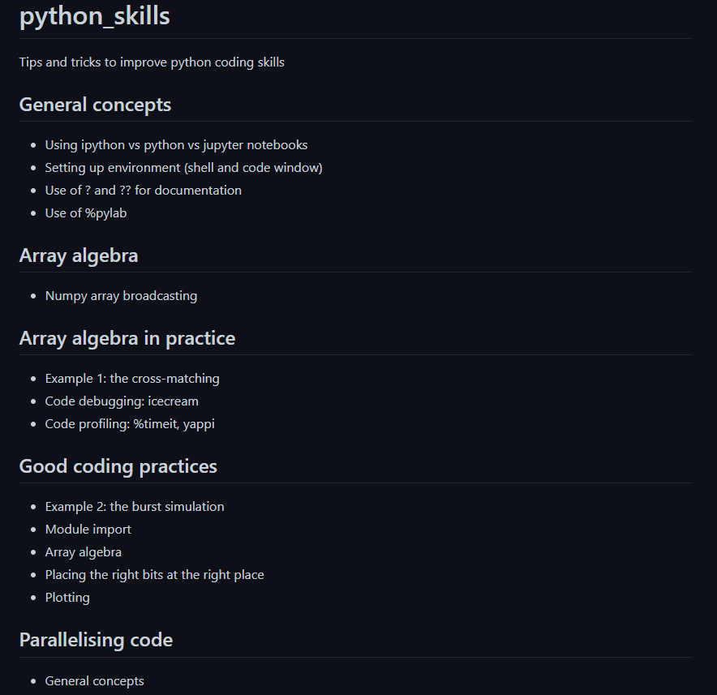
Want to be a Python Jedi?
Check out Rene’s JACS material from previous years - https://github.com/bretonr/python_skills

Slide 34
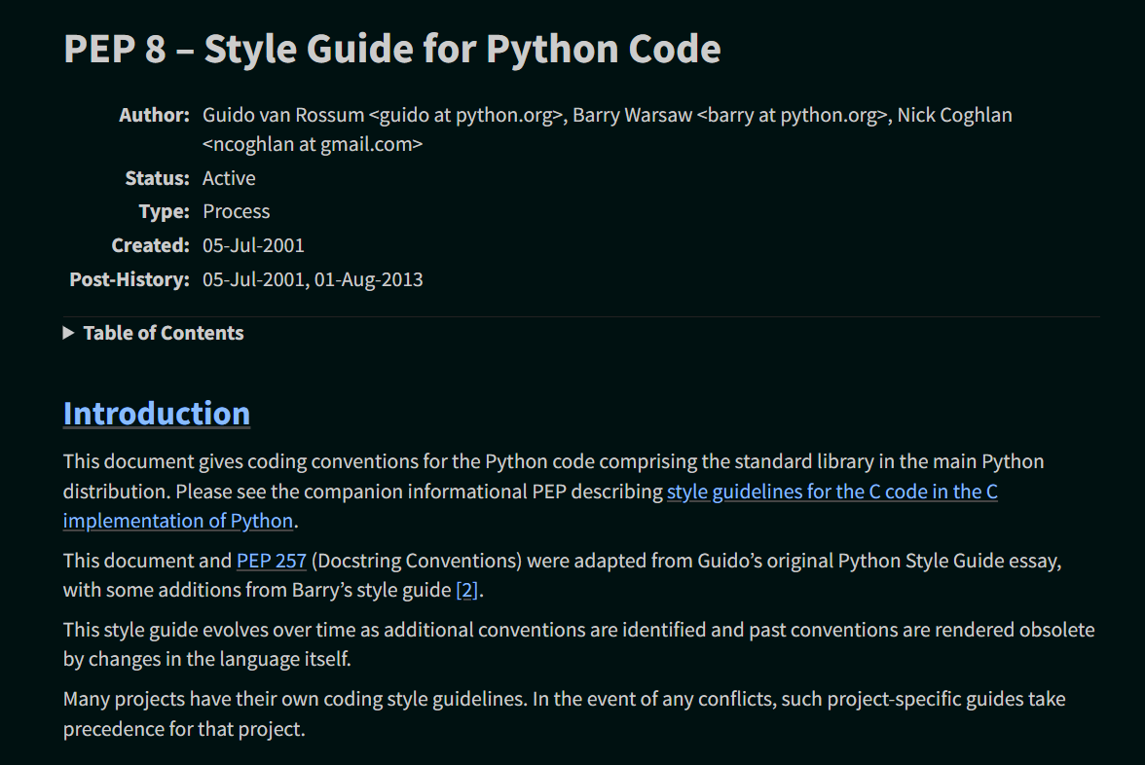
PEP-8 Documentation
Style Guide for Python Code- https://peps.python.org/pep-0008/

Slide 35
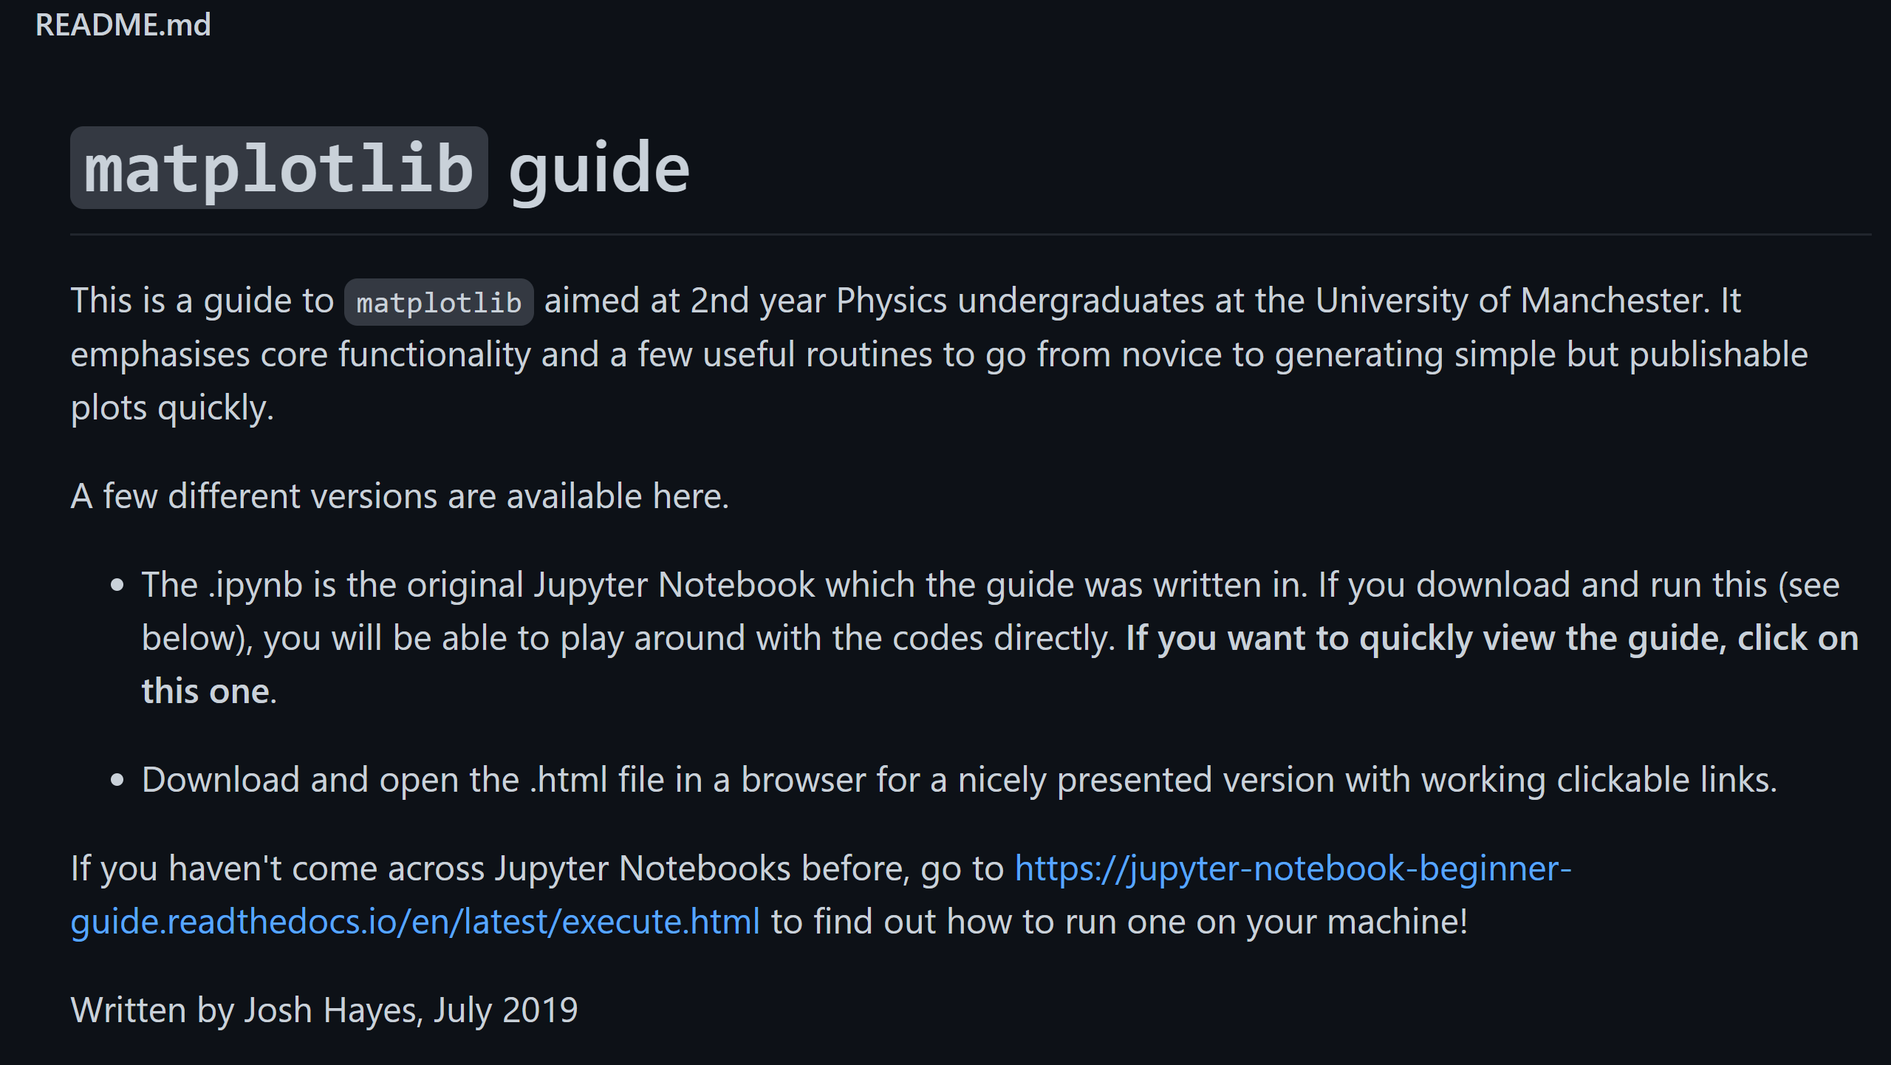
Matplotlib Guide
Want a quick start guide to visualisating data in Python using Matplotlib? Check out Josh Hayes’ repo: https://github.com/joshjchayes/matplotlib_guide

